Slide 1
M&A
Why Information Security should be sitting at the main table
Dr. Marco Ermini, CISSP CISA CISM
2018 Telefónica Germany

Slide 2
Agenda
Why M&As need Cyber Security support? (7)
Threats and Risks (2)
The Four “C”s (18)
The Security Manager (7)
Leveraging the Cloud (4)
Open Source Information Gathering (backup slides) (37)
Notes:
Why does a merger or acquisition need security support?
Aren’t mergers and acquisitions just ordinary business transactions?
They seem to occur nearly every day, so what is so special about them that they require special security support, or any security support at all?
What value does a security professional bring to a merger and acquisition team?
<number>
12/06/2017

Slide 3
Why M&As need Cyber Security support?

Slide 4
Why M&A Security?
Aren’t they just ordinary business transactions?
They seem to occur nearly every day, so what is so special about them that they require special security support, or any security support at all?
What value does a security professional bring to the team?
Notes:
Why does a merger or acquisition need security support?
Aren’t mergers and acquisitions just ordinary business transactions?
They seem to occur nearly every day, so what is so special about them that they require special security support, or any security support at all?
What value does a security professional bring to a merger and acquisition team?
<number>
12/06/2017

Slide 5
The Academic Minute…
Black’s Law Dictionary defines mergers and acquisitions as the following:
Merger: The union of two or more corporations by the transfer of property of all, to one of them, which continues in existence, the others being swallowed up or merged therein…
Acquisition: The act of becoming the owner of a certain property…
Divestiture: to deprive; to take away; to withdraw
Notes:
Practically speaking: there is almost always a winner and a loser.
<number>
12/06/2017

Slide 6
The Academic Minute…
Acquisition of Total Assets
Liquidate
Break up and sell
Integrate
Acquisition
Merger
Divestiture
Notes:
Acquisition of Total Assets: a transaction in which one company purchases the total assets of another company; one company acquires another company to do with it as it sees fit.
1. Liquidate selling off all of its assets for their individual value (occurred during the early 1980s when the economy was growing and interest rates were high, making assets more valuable).
2. May break up into different business units or product lines and sell some or all of them. Usually done because an assessment is made that the individual business unit or product line is not part of the strategic direction of the company; may need an immediate cash infusion: a method of eliminating a competitor, providing that such a transaction, as applicable, is approved by the country’s government regulators.
3. The acquiring company may choose to keep the entire company it purchased and integrate it into itself, creating a larger company from the two smaller companies. Capitalize on the capabilities of both companies as they are shaped into a single new company, take advantage of any synergies created from the acquisition and leverage to create a financial gain. New technologies, expanded product lines, patent portfolio, or increased knowledge capital.
Acquisition: the acquiring company is interested only in obtaining a specific business unit or product line. The acquiring company makes a determination that it would benefit from the addition of a new technology, a new product, an expansion of its existing product line, or a new business area to become more competitive in its chosen marketplace.
Merger brings two companies together to form a single new company. In this instance, both companies agree to come together, generally as equal partners, with each bringing something unique to the union. Generally, each company brings something the other lacks, thereby improving the capabilities of the newly created company. Neither company has an advantage after the merger, as both companies combine their people, assets, and capabilities to form a new entity.
Divestiture is a transaction that results in the sale of a business unit or product line. For example, a divestiture may occur when a company chooses to sell one of its product lines to another company. The selling company may conclude that it no longer chooses to be in the business of producing that particular product, or it may need cash and can best raise it by selling one of its business units or product lines.
<number>
12/06/2017

Slide 7
The Academic Minute…
It is all about…
Costs Control,
Market Share,
Regulatory Landscape
Others…
Notes:
Cost control: In an environment where competitors aggressively try to find ways to increase their sales, revenue, and profits, the loss of market-share is not uncommon. Generally, the initial reaction under these difficult conditions is to cut costs.
Cutting costs usually begins with cutting jobs. Quite often, consequences of this are overlooked in the wholesale effort to slash costs.
Expand market-share is the counteraction to cost-cutting. One effective way to increase market-share is to acquire another company operating in the same marketplace. One acquired company may be native to the marketplace in which the acquiring company wishes to penetrate and has a greater market-share in that marketplace than the acquiring company. When one company acquires another, along with the acquired company comes its market-share.
The changing of government regulations can drive, enable, and even encourage companies to pursue divestitures, mergers, or acquisitions. Deregulation within the media, telecommunications, utilities, and health care industries has led to increased merger and acquisition activity.
Others…
Technological Changes and Developments
Financial Marketplace Conditions
Consolidation
External Investment Alternative to Internal Growth
Divestment of Non-Core Businesses
<number>
12/06/2017

Slide 8
Business Drivers
Confidentiality
Speed
Business as usual
Zero Impact
Informed Business Decision on Risk

Slide 9
Why M&A Fail?
The acquiring company does not properly assess the value of the target company
Inability of the acquiring company to successfully integrate the target company that leads to a failed acquisition
“It is well known in the M&A community that most acquisitions fail to create shareholder value, that is, they end up as a negative sum after paying acquisition premium and banker fees, impossible to get synergies to make up loss. The acquisitions that do create value are either a version of corporate venture capital (large company scooping tiny team), or mid-cap industrials buying a supplier. Few and far between…“

Slide 10
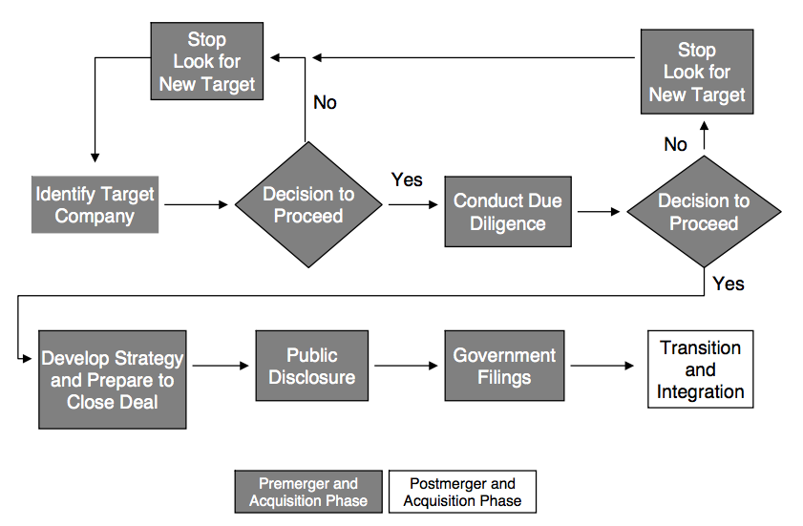
Typical M&A Diagram Flow

Slide 11
Threats and Risks

Slide 12
Scoping the Threats
Special Interest Groups – gain from the Operation
Financial Criminals
Competitors
Acquisition / Merger Company
Disgruntled Employees
General Interest Groups – gain from Impact
Script Kiddies / Hackers
Hacktivists / Terrorists
Spies

Slide 13
Scoping the Risks
Publicity, raising profile — your interest gets attacker’s interest!
Impact on:
Resources
Technologies
Infrastructure
Disgruntled Employees
Change in threat and risk model
Absorbing unknown / Confusion
Creating new attack vectors and window of opportunity
Business drivers can force this the Security Manager very quickly
Are we all really equipped for change?
Notes:
One of the few times an Organization is really “shaken up”
<number>
12/06/2017

Slide 14
Typical Approach – The Four “C”s
Capture
Connect
Combine
Consolidate
Notes:
Capture. This process is ubiquitous to all deals. During the capture process, ITSEC collects information on assets, people, budget, and strategy from both internal functions and the Target to evaluate security and risk profile. Internally, information on the strategic intent of the deal is provided to the ATEAM. Other information includes facilities disposition, product plans, and organizational plans; this information aids in overall security planning.
Connect establish connectivity for the initial core infrastructure, setting up primary communication and collaboration tools and systems. This stage typically involves an interim step of creating a VPN tunnel, followed as quickly as reasonable by LAN/WAN interconnection, and then integration of other core IT infrastructure services. The connectivity can follow different steps, depending on the complexity and size of Target. The first focus is on immediate connectivity.
Combine: Integrate business systems and processes.
Consolidate: Realize economies of scale through organizational asset consolidation.
<number>
12/06/2017

Slide 15
Capture

Slide 16
How can I verify an M&A Target candidate?
You cannot explicitly test your acquisition’s candidate
You cannot simply ask them for their vulnerability assessments’ results
Not all companies have a structured and mature security program
You cannot silently test them either
Notes:
There are both practical and ethical issues involved in assessing the security of systems you do not own. Trying to break into computer systems that you do not own is illegal, even if you are doing it to test their security (Electronic Frontier Foundation, 2013). This is why it is best to use public information, so there will be no legal repercussions from the assessment.
Simply asking for vulnerability information from a business partner may not be successful. This is considered highly confidential information and it could damage the company if it was inadvertently released. This is assuming the company has the information.
Not all companies have a formal vulnerability management program even though they may have competent IT support. A small or even medium sized company may not have knowledgeable security staff to conduct the scan or the money to hire a consultant. Even companies with this information may just feel they don’t want to take the time to provide it.
Doing an unannounced vulnerability scan of someone else’s perimeter is not a good way to either start or continue a business relationship. An intense scan can cause a website to crash or fill up available bandwidth. The increased traffic could even result in increased web hosting costs. When companies scan their own systems it is generally done during defined maintenance windows to avoid interfering with production systems. For example, IBM warns against scanning ports running HACMP services since this can cause a system crash (IBM 2008).
<number>
12/06/2017

Slide 17
External Sources
Professional Associations
Service Providers
Public (Open) Sources
Job Applications/Job Postings
Notes:
Associations: Professional associations are useful sources for information. To obtain information from them may require association membership. Generally, a membership fee is required to participate. In turn, relevant industry information is available to its members. Limited company-related information may also be available. Information brokers: These brokers are individuals, organizations, or companies that collect and sell information. They may specialize in specific types of information (e.g., financial, political). They have many sources for the information they gather, sort, and make available to their customers for a price.
Service providers: Companies that conduct investigations and perform due diligence work are also information service providers. The information that they provide is gathered from many sources to include assessments made of specific organizations through their investigation process.
Public sources: These sources are available to anyone and are essentially free or at very low cost. Public libraries, news media, and the Internet all possess and make available a wide variety of business, economic, political, legal, and cultural information, which may be useful in learning about another company, business, market segment, or nation’s economy.
Job applicants: Job applicants are another potential source for gathering information that could be useful in developing intelligence.
Obtaining relevant information is best accomplished during the job interview process. During this process, a candidate is often willing to share information about what they have been working on in order to demonstrate their capabilities and potential value to a prospective employer. During the interview, candidates will do their best to sell their services, and in some cases that means sharing more information than they should. An important part of selling oneself to a prospective employer is to convince them you are the best person for the job. One way to accomplish this is to use examples of one’s role in the development of a new technology or new product. Again, caution should be exercised, and interviewees should be instructed by the interviewers that trade secrets and other proprietary types of information of former or current companies is not being solicited or wanted.
<number>
12/06/2017

Slide 18
How that does look for real…
Notes:
If you are part of the deal’s team
Use of a software from a third party firm (e.g. Deloitte D-Rooms)
Asset inventory and technologies used are derived from end-of-year taxes’ books (inventory and depreciation)
<number>
12/06/2017

Slide 19
Due Diligence Toolkit
Available here: https://github.com/markoer73/M-A
Notes:
Associations: Professional associations are useful sources for information. To obtain information from them may require association membership. Generally, a membership fee is required to participate. In turn, relevant industry information is available to its members. Limited company-related information may also be available. Information brokers: These brokers are individuals, organizations, or companies that collect and sell information. They may specialize in specific types of information (e.g., financial, political). They have many sources for the information they gather, sort, and make available to their customers for a price.
Service providers: Companies that conduct investigations and perform due diligence work are also information service providers. The information that they provide is gathered from many sources to include assessments made of specific organizations through their investigation process.
Public sources: These sources are available to anyone and are essentially free or at very low cost. Public libraries, news media, and the Internet all possess and make available a wide variety of business, economic, political, legal, and cultural information, which may be useful in learning about another company, business, market segment, or nation’s economy.
Job applicants: Job applicants are another potential source for gathering information that could be useful in developing intelligence.
Obtaining relevant information is best accomplished during the job interview process. During this process, a candidate is often willing to share information about what they have been working on in order to demonstrate their capabilities and potential value to a prospective employer. During the interview, candidates will do their best to sell their services, and in some cases that means sharing more information than they should. An important part of selling oneself to a prospective employer is to convince them you are the best person for the job. One way to accomplish this is to use examples of one’s role in the development of a new technology or new product. Again, caution should be exercised, and interviewees should be instructed by the interviewers that trade secrets and other proprietary types of information of former or current companies is not being solicited or wanted.
<number>
12/06/2017

Slide 20
“Capture” of Security Controls
13 Domains to verify
Digital Identities
Admin Accounts
Endpoints/Client Systems
Servers
Networks
Hosting
Email
Data Recovery
Boundary Defences
Assets Inventory
Operational Security
Physical Security
Wireless Networks

Slide 21
Example of Policy Requirement
Domain | Verification | How-to | Objectives | Minimum Acceptable Level
Digital Identities | Verify status of identities in main identity store (use of unique IDs, generic accounts, password policy, Groups’ usage, GPOs, Federations, etc.). Verify if anything is outside of the main identity store (e.g. VPN accounts, Cloud accounts, supplier accounts, etc.). | Interview with IT admins from Target. Snapshot of information from AD/LDAP. Interview with business units which manage other tools (Cloud etc.), to understand how this is managed | Ensure appropriate controls are in place to protect Target environment and data Get an idea of the complexity of the DI structure of the Target. Understand usage of Cloud applications and identities. Understand how restriction of access to information happens in Target. | There is a Directory Service Unique IDs are used Permissions are assigned via Groups in the Directory Service Service and Cloud accounts are gathered, minimized, and under control Sensitive files are shared in a secure way
Admin Accounts | Verify status of admin account management in main identity store, if managed there. Verify if anything is outside of the main identity store (e.g. VPN accounts, Cloud accounts, supplier accounts, etc.) | Interview with IT admins from Target. Snapshot of information from AD/LDAP and other tools. | Ensure admin account controls are defined, implemented and reviewed to protect systems and data Understand how IT administrative actions are performed, what the procedures and practices are, and who has the ownership and responsibility. | Admin accounts are managed under a Directory Service Admin accounts are unique for each admin Central ownership of who gets appropriate rights Process for removing rights as appropriate

Slide 22
Example of Interview Questions
Domain | Minimum Acceptable Level | Key Topics for Discussion
Digital Identities | Directory Services of any kind are used Unique IDs are used Permissions are assigned via Groups in the Directory Service There is an adequate password policy in place Service and Cloud accounts are gathered, minimized, and under control Sensitive files are shared in a secure way | How many people are present in the company? Get overview of employees’ org chart/roles, and how many people are in IT and Security. How old is the company? Get brief history, acquisitions, etc. Which DS is used? (AD, which version?) Get overview of Groups, GPOs, shared accounts, shared mailboxes, federated services, password policy (for AD, request screenshots). Is every system and device connected to DS and follow password policy, or there are systems which have their own passwords (e.g. Wi-Fi, network devices, etc.)? What is the process by which Group ownership, permissions and accesses to systems and applications are granted? Get overview of Cloud services used and how accounts are managed, if SSO is used and how, especially concerning files and documents sharing with third parties. Is Cloud Sharing such as Box, Dropbox etc. being used?
Admin Accounts | Admin accounts are managed under a Directory Service Admin accounts are unique for each admin Central ownership of who gets appropriate rights Process for removing rights as appropriate | Get overview of how administration is performed, if AD Groups and GPOs are used, if shared accounts and/or shared mailboxes are used for admin accounts Understand how permissions are granted and removed from users as their work and function changes in the company

Slide 23
Risk Assessment
Management Summary with a clear status
Clearly indicate the area that will need additional attention
Especially indicate where the additional costs will incur (e.g. new wireless equipment, re-imaging of the endpoints, reimplementation of firewall, etc.)

Slide 24
Impact Assessment
Indicate the kind of impact:
Security
Processes
Costs
Indicate expected remediation, aligned with IT
If not possible to estimate costs immediately, indicate how they should be calculated (e.g. need to provision new firewall cluster)
Notes:
Security: risks may be due to insufficient policy controls that need to be addressed with a remediation (e.g. Terminal Servers opened on the Internet, patch management not following best practices, etc.)
<number>
12/06/2017

Slide 25
Summarize Findings aligned with IT – in one Slide

Slide 26
Costs aligned with IT for integration

Slide 27
Connect

Slide 28
Starting to work in Clear Sight
The news is out
Information Completeness is paramount
An Integration Plan is proposed
Technical Integration
Networks, PCs, applications, data centres, hosting…
Business Processes and Systems
Timing
The Integration Plan must also negotiate from an “as-is” to a “to-be” state for the Target
Notes:
This phase of the acquisition is probably already happening “in clear sight” that is, the basic risk assessment has been performed and the acquisition is public news. In this phase, information completeness is paramount.
After this first assessment is complete, through an evaluation of the existing environment the ATEAM will have to propose an Integration Plan. The integration plan requires specific budgeting for the necessary infrastructure services to be integrated or replaced, as well as business processes and systems, and timing.
The Integration Plan includes three sections:
Technical integration: this includes LAN/WAN, voice, client computing, PC hardware, productivity applications, data centers and hosting, engineering tools, backup solution, printing, video and telephony, and other infrastructure services.
Business processes and systems: evaluate existing business processes and systems, working with business owners to identify process changes and facilitate process and system changes to enable business functions. Business functions include IT support for hardware and software, engineering, manufacturing, HR including new hires and leavers’ processes, sales, manufacturing, internal and external web, finance, customer services, business-to-business and suppliers management, and so on.
Timing: negotiate for agreement on the overall plan and timing, aiming for an overall agreement between all affected parties must be reached on how and when the Integration Plan will be implemented. Primary stakeholders include us, Target and ATEAM members and/or virtual teams involved in the acquisition.
<number>
12/06/2017

Slide 29
Combine

Slide 30
Target Characteristics | Security Guidelines | SLAs
SMALL Small employee base (< 200 employees) Low complexity Private ownership Little to no geographical diversity No separate legal entities No/limited need to keep the same facilities No/limited to keep the existing technologies Purchased for limited product portfolio, technology, talent, or local presence | Baseline security controls Target is fully absorbed into IT infrastructure All IT labor is absorbed into IT global business units | Security controls established or confirmed in less than 100 days
MEDIUM Similar to previous kind, but Target has certain identifiable complexities that require specific sensitivity during integration Fewer than 500 employees Needs to be stand-alone for a certain period of time During stand-alone time, Target maintains defined non-compliances Supports its own IT infrastructure during the stand-alone phase | Integration of Target may be full, hybrid, or standalone All IT labor is absorbed into IT global business units | Operation integration of some IT infrastructure may take +180 days Processes may take 3 to 9 months
LARGE More than 500 employees Relatively large operations Significant multinational presence and subsidiaries Target contains certain identifiable complexities that require specific sensitivity during integration | Integration of Target may be full, hybrid, or standalone IT labor can stay funded by Target company | Operation integration of some IT infrastructure may take +180 days Customized integration plan IT Support is shared Processes take more than 12 months

Slide 31
Combining the two companies
Resources, staffing, processes, and systems are combined
Business processes are as much as possible levelled
IT tools are unified
Active Directory merging strategy is key!
The Target company has comparable / same security
Exceptions are documented and signed off by leadership (executives, CISO)
Agreed-upon designs are implemented
Operations — including InfoSec – are turned to standard support
Weekly or recurring meetings can be setup to assess progresses
Notes:
Resources, staffing, processes, and systems are combined
Business processes are as much as possible leveled
IT tools are unified
The Target company has assumed a comparable or the same security posture as the acquiring company
Differences in processes and IT Security posture, as well as “misses” from the Integration Plan, are documented and signed off by key stakeholders (leadership, executives, CISO)
The agreed-upon designs are implemented, and operations — including Cyber Security – are turned over to standard support
Weekly or recurring meetings can be setup to assess integration phases are carried out as expected, and do follow IT Security best practices
<number>
12/06/2017

Slide 32
Planning the Active Directory Integration
Training for the technicians performing the migration
Scheduled outages
Companies’ cultural differences such as who's allowed access to AD and Exchange, or how file system security is set
Network differences between the two sites
Network, AD, or Exchange anomalies
Customer and employee communication

Slide 33
Pain Points in Active Directory Integration
Deciding the strategy
Integrate the Target into the Acquiring
Build a new, combined AD
Migrate legacy objects into a new AD
One Company, One Email!
Free/Busy Information
Exchange/Lync/Office/AD versions
Office 365?
External Federations/Partners/ADFS?
DNS configuration/forwarding
SID history/filtering
Evaluate purchase of a dedicated AD migration/upgrade tool

Slide 34
Merging and Adjusting Policies
Safeguards against disgruntled employees
New employee contracts
Are existing Policies still relevant?
Are we “dumbing down” their security?
Existing employee contracts
Do they protect you?
Do they meet new relationship?
Identify key policies — yours vs theirs
Work with Legal Departments

Slide 35
The Security Manager

Slide 36
The Role of a Security Manager (1/2)
Protecting the effort itself
Confidentiality of the total effort
Confidentiality of the team’s work
Evaluating the security condition of the target company
Impact on the deal’s value
Asking the right questions
Notes:
Protecting the effort itself: Security measures are applied to the merger or acquisition effort to ensure that it is properly protected. That includes the implementation of measures to protect the confidentiality of the effort and its people, information, and physical assets.
Confidentiality of the total effort: For competitive reasons, it may be necessary to keep the existence of the effort unknown to all but the merger or acquisition team itself. At some point in time, all mergers and acquisitions become known, but that occurrence must be controlled, deliberate, and approved by executive management. It must not be accidental or happenstance.
Confidentiality of the team’s work must be maintained: Specific strategies, plans, processes, analysis, and assessments must not be revealed to people outside the team without the expressed permission of team leadership, or another in the executive management chain. Unauthorized releases may compromise or harm the effort. An unauthorized release of information may allow a competitor to gain information of value at little or no cost to itself.
Evaluating the security condition of the target company: The security manager is charged with assessing the security condition of the target company. Ideally, the security manager conducts a security audit of the target company’s security program and overall security condition, which becomes part of the total team’s assessment. Any issues identified are given consideration in terms of their effect on closing the deal. Unless severe security problems exist, security issues generally never break the merger or acquisition (deal). However, security problems or a substandard company security program can impact the value of the deal. Anything that may affect the value of the deal must be given serious consideration. Failure to do so is something less than a proper due-diligence effort.
<number>
12/06/2017

Slide 37
The Role of a Security Manager (2/2)
Providing subject matter expertise
Identify Security Requirements for the New Company
Controlling Rumours
Managing Global/International Aspects
“Team Consultant”
Low Hanging Fruits
Notes:
Providing subject matter expertise: The security manager or professional serves as a member of the team and provides guidance, direction, and consultation on all security-related issues and concerns.
Identify Security Requirements for the New Company
The combination of two companies into a single larger company changes that company in many ways. Those changes should be anticipated and evaluated in terms of future security requirements. Some of the security needs of the newly created company may be driven by the security condition of the two companies coming together. Any security problems or vulnerabilities identified during the assessment phase will require attention during the integration phase. Understanding the impact of security problems and vulnerabilities early on will allow more time for planning and development of mitigation measures. In some cases when two companies come together, it may not be practical to simply impose the security practices of the acquiring company on the new company. The structure and operations of the new company may be so different from either heritage company that the overall security needs and requirements for the newly combined company may now differ significantly. If this is the case, much work will be needed in assessing and understanding those needs and developing procedures and practices to support them.
Controlling Rumors
Preventing rumors is impossible. Limiting and controlling them are possible. Frequent, open, structured, honest, and planned communications will cut down on the development and spreading of rumors.
Global/International Aspects
If the merger or acquisition effort involves companies from different countries, the role of security becomes more involved and demanding. International travel, laws, and regulations from multiple countries and cultural and language differences along with differing business practices make the task of protecting the effort, people, and information more complicated. Having an understanding of international business issues will be helpful. Having a security manager on the team with experience in international business, and security will be invaluable to the effort. When an acquisition team leader selects a security manager to support the team, the leader should keep in mind the importance of international business experience.
Team Consultant: Part of the role for security is to serve as the team’s “in-house consultant,” that is to say, serve as a subject matter expert and help the team learn as much as possible about the target company, particularly as it pertains to matters of security.
<number>
12/06/2017

Slide 38
Importance of Confidentiality
Premature Disclosure of Intent
Loss of key employees
Bidding wars
SEC Liability
Loss of Initiative
Loss of Goodwill
Target Company
3rd Parties relationships
Customer relationships
Notes:
In the event a company is proceeding down the path of a hostile takeover action, at least in the early stages of the process, the acquiring company may not want the targeted company made aware of these plans. If the target company does become aware of plans to acquire them and it is not interested in being acquired, it may have sufficient time to develop a variety of defensive measures to prevent itself from being acquired. Hostile takeovers make for very good drama. Keeping a low profile for as long as possible can help prevent or mitigate this distraction.
12/06/2017
<number>

Slide 39
Protecting the operation
Unintended Release
Unauthorized Release
Protection from competitive intelligence efforts
Documents Control
Notes:
Unintended release: More often than not it is caused by carelessness on the part of overworked employees or employees not fully understanding their obligations to protect sensitive information and not fully understanding the degree of sensitivity of that same information.
Unauthorized release: The release is deliberate for reasons not necessarily to the benefit of the merger and acquisition team or the company. Ensuring that all employees and team members fully understand the consequences of releasing information without authorization is essential.
Protection from competitive intelligence efforts: Protecting information from being collected through legitimate means requires policies, procedures, and protocols to be in place that clearly establish mergers or acquisition information sensitivity and handling methods. It also requires training team member so that they are aware of how they may contribute to this process and what actions they may use to mitigate collection efforts or at least not support them or make them easier.
Protecting information from being collected through illegitimate means is a different ball game. As much as possible, such processes should follow the normal company processes for the protection of sensitive company information. The primary difference is to compartmentalize that information in a strict need-to-know working environment.
Document control: Much of the material handled in support of a merger or acquisition is routine business information. However, if the team’s intentions are to keep the effort unknown, then nothing is routine. Any information that could reveal the existence of the effort, if exposed, must be protected. This includes simple items such as telephone notes and routine correspondence containing information revealing the efforts existence.
Procedures for the project team’s control of information in document or written form should be developed and implemented for use by all. Any procedures used should be as similar and consistent to normal company protective practices as possible.
<number>
12/06/2017

Slide 40
The Security Manager in action
Preliminary background investigations
Collection of Open-Source information
Due diligence
More in-depth look
Estimation of Costs of Cyber Security
Operations security
Protect operational activities
Develop and implement protective measures
Appropriate for each phase of the acquisition
Notes:
Preliminary background investigations: Learn as much as possible about the target company and its leadership. All knowledge gained early will have value in later phases. The more the merger and acquisition team can learn about the target company the greater the possibility of good business decisions being made.
Due diligence: During the due diligence phase of the effort, the merger and acquisition team has an opportunity and an obligation to take a more in-depth look at the target company. This examination is still limited. How extensive it becomes may require an agreement by both companies. Nevertheless, it will be an opportunity to learn more about the target company than is available from open sources. The time frame for the due diligence is limited but should be sufficient to allow for obtaining enough information about the company so that when this information is combined with data gathered from other sources as well as open sources, chances of making the correct decisions are enhanced. It is during this phase that the team leadership identifies and considers all problems and concerns. The problems are evaluated and a decision is made to proceed with the merger or acquisition or abort the effort
Cost of security: Within most companies, security is a cost center and not a revenue center. Unless the company is in the business of selling security products and services, security does not usually generate revenue. Like other supporting functions, the security organization exists to fulfill a protective and compliance role. Company assets protection, driven by laws, regulations, and the need to mitigate risks, are the reason security organizations are formed. Moreover, to protect their own interest, most companies establish a set of rules (policies and procedures) to provide a protective framework for employees to operate within. This costs money.
Operations security: Operations, or operational security (OPSEC), refers to the measures and controls applied to the effort to ensure that the day-to-day activities of the team are protected to the extent appropriate. The security manager is responsible for leading this effort and for developing and implementing the necessary protective measures. Protective measures vary with each phase of the effort, as each phase differs in its need for control. For example, the initial discussion concerning the team’s intentions to acquire a target company and the background assessments of that company and its executives generally need to occur under very tight controls. Preventing knowledge of the discussions from becoming public could have competitive and legal implications. For example, if publicly traded companies are involved, information suggesting the possibility of a merger or acquisition could have an impact on the stock price of one or both companies.
<number>
12/06/2017

Slide 41
The New Security Department
Cost/Budgeting
Pre-merger: OpEx
Merger: CapEx, Processes
Post-merger: Optimization
Communications
Notes:
During the pre-merger period most of the costs encountered by security are labor costs due to due diligence. To ensure that sufficient security expertise is supporting the merger and acquisition team, the security manager uses company security professionals or security consultants to do the necessary work.
Merger phase implies acquisition of the tools, hardware and licenses required to cover the security of the acquisition. Any analysis of security issues and concerns must consider the impact on the total effort, other functions, and the company as a whole. When assessing security issues, keep in mind the potential impact to affected organizations. For example, if a target company conducts business internationally with operations in high-risk countries, those operations should have in place contingency plans appropriately developed to mitigate those risks. If they do not have contingency plans in place, they may be operating at a higher degree of risk than is acceptable to the company. The extent of that risk varies depending on the size and value of the operation.
During the Post-merger period, the security manager focuses on what it costs to provide security to the new company. When two companies come together as one, the security statement of work must be changed. It must be adapted to meet the security needs of the combined companies. With a change in the security statement of work will come a change in the cost of security.
Optimization: The cost of security for the new company will be expected (by company leadership) to amount to something less than the combined cost of security for the two companies when they were separate. The security manager will be expected to achieve cost savings when bringing two security organizations together.
<number>
12/06/2017

Slide 42
What if I am on the weak side?
Identify specific strengths that can be useful in the merging
Experience from security incidents
Technological implementations
Local knowledge and compliance
Be prepared to learn
What is the current Cyber Security philosophy?
Who is taking security-related decisions?
Don’t rush your career decisions
Can bring new opportunities
Meet the new management
Notes:
As you do your research, begin to figure out how your specific strengths may be of value to them. For example, if the acquiring company has previously been a victim of an information security breach that involved theft of customer information, you may have specific skills that can directly benefit them. If you have recently been involved in implementing a DLP product, or if you have a background in computer forensics or incident response, your skills will have increased value. On the other side, if your company is a small regional bank that is being acquired by a larger financial services company, it is doubtful that your technical skills will not be duplicated. However, your knowledge of compliance with specific regulations may be unique and represent value. The key no matter what the situation is to identify the unique value you offer to the new business entity.
Independent of this, however, the more that you are able to learn about the business during this time, the more prepared you will be in terms of how the business operates, what the organization's infosec philosophy is and which people are likely the ones who will make key security-related decisions when the acquisition takes place. This preparation and education should provide you with a solid framework for future career decisions.
When an acquisition is announced, it is common to think about the effect it will have on your career. As information security professionals, we are programmed to think about risk and impact, and we often assume the worst. For example, when a large company purchases a smaller one, it is natural to think that the larger company will destroy the smaller company's culture, misunderstand the specific information security skills of its employees and force everyone to assimilate. While these assumptions may turn out to be accurate, it is important to fully understand the business strategy behind the acquisition before jumping to your own conclusions. Many times, the strategy behind these acquisitions includes the acquirer's desire to purchase intellectual property and professional talent in a more efficient manner than it could otherwise, which can grant leverage to the employees of the company being acquired. There may even be specific reasons why the skills of the information security staff may be critical to the company's long-term plan. For instance, the acquiring company has the framework for utilizing a greater breadth of your information security skills, and has the necessary resources to enable you to develop your career and support your goals. For example, large companies have broader customer offerings; if you have knowledge in a breadth of information security disciplines, like application security and network security, you may find that a larger company will see greater value in (and have greater application for) your skills, than either a specialized application security or network security company would.
During an acquisition there are two potential business management outcomes: Either your manager will remain the same, or your manager will change. If your department management remains intact, there is a good chance that you may have the opportunity to expand your role. However, if your management does change, you should not automatically assume it will negatively affect your information security career.
A new manager can provide an opportunity for professional development and career advancement, as he or she will come with different experiences, management styles and philosophies on information security. The better you are able to understand his or her way of thinking and managing and whether it's a good fit with your skills, personality and work habits, the better you will be able to determine if this change will be beneficial to your career.
For instance, the new manager may have a new mandate for the information security function that better aligns with your skills. Your new manager may also have philosophies around skill development and people management that align better with your goals and your work style. More specifically, you may have been frustrated with the amount of training that your past manager fostered, but your new manager may allow you discretionary budget to select information security-related training that aligns better with your interests.
It is important that you understand that managers are working through changes, too. They are under a good deal of pressure from new leadership to perform. If you can show your new leader that you appreciate this and attempt to make his or her transition easier by aiding the integration of the two information security groups, he or she will most likely appreciate your help, cementing your position as a valued member of the new team. One such tactic is to help the new manager understand the work environment and culture of your organization. You can do this by introducing him or her to key people in the organization (security, technology or business) who can ease the transition and enable them to be more productive. If you can be seen as a trusted resource, it's likely that you will receive better (and quicker) insight into the new manager's leadership style.
As information security professionals, we need to accept that mergers and acquisitions career management is a fact of life. Although these events cannot be controlled or predicted, they can be planned for. By dispelling preconceived notions and avoiding knee-jerk reactions, you can clearly evaluate these new opportunities for what they are: transitions that can have a positive effect on your career.
<number>
12/06/2017

Slide 43
Leveraging the Cloud

Slide 44
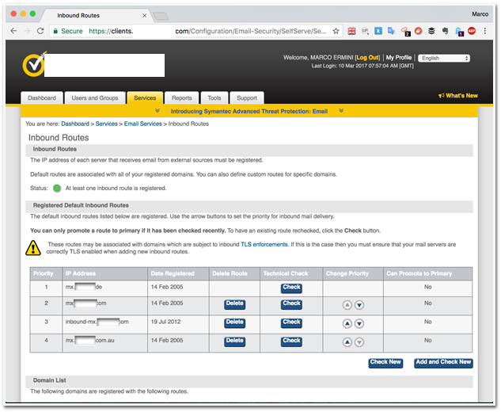
Cloud Email Gateways

Slide 45
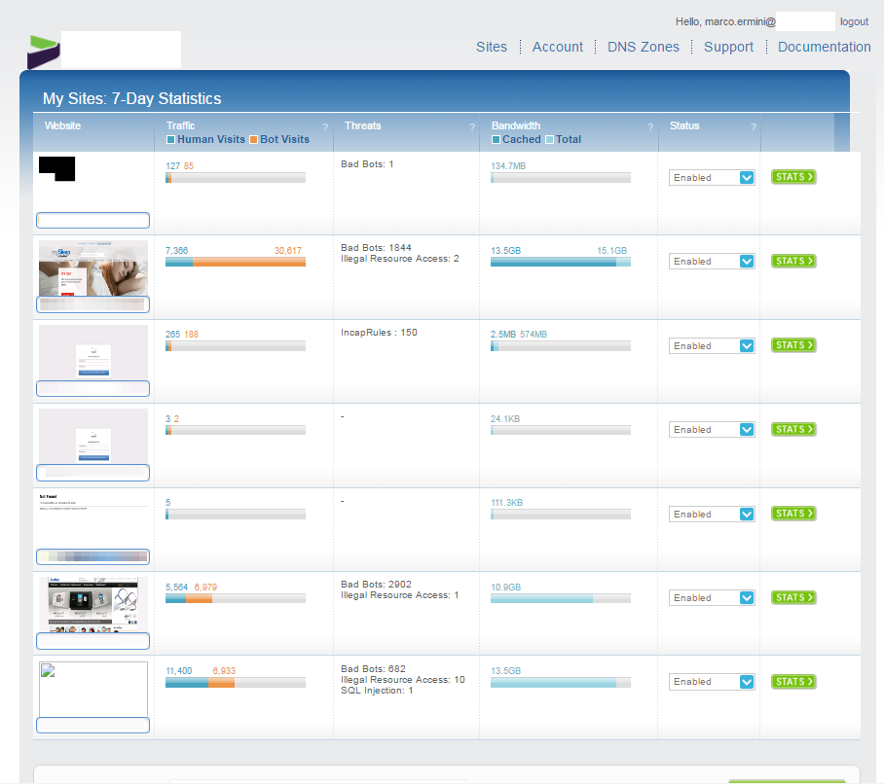
SaaS WAF/CDN
Notes:
12/06/2017
<number>

Slide 46
Moving to a Cloud-Based ERP or Email Solution
Traditional M&A dogma is “transition, then transform”
Companies however are leveraging migration to key technologies to the Cloud during the M&A process as an enabler
Can simultaneously replace aging, capital-intensive technology with a subscription-based operating model
Ideal also for divestitures
Boarding is considerably faster and cheaper than traditional on premise solutions (Accenture estimates 30% for both)
Ultimate flexibility during a post-deal transition
Notes:
While conventional M&A dogma has counselled to “transition, then transform,” emerging cloud-based Enterprise Resource Planning (ERP) technology affords executives new options to have their cake and eat it too. Cloud technology now gives executives the opportunity to simultaneously transform not only their cost structure but also their capabilities by replacing aging, capital-intensive technology with a more edible, subscription-based operating model that can ramp up or down as business needs dictate, as well as accessing advanced cloud-based capabilities based upon best practice.
Today’s competitive business environment is driving companies to focus on core strengths and most pro table activities. Executives are increasingly looking to divestiture as a method to shed underperforming or non-core assets.
Amidst the focus on separation, it is often impractical to develop all of the required infrastructure to support the new organization, and it is common to include Transition Service Agreements (TSA) in which the seller provides post-deal, operational services or support to the buyer for an interim period of time after the transaction closes. As TSAs often include severe financial penalties for not exiting the agreement prior to the agreed upon date, there can be considerable pressure on both sides to exit quickly and with minimal impact to the business. This can be challenging, however, if the TSA includes support services for a traditional, on-premises or hosted ERP system, due to the complexity involved with ERP system configuration.
Moving to a cloud-based ERP system may help turn a potential M&A deal breaker into a deal maker. Opting for a cloud ERP solution can be a practical, less costly alternative to traditional on-premises or hosted solutions and should appeal to both seller and buyer. Requiring no hardware and nominal configuration, a medium-sized company can often be operational on a cloud-based ERP in four-to-seven months and a large international in approximately twice that time—both typically faster than traditional on-premises solutions—thereby facilitating a faster exit from the TSA. Considering that a cloud ERP typically provides regular upgrades, the ability to scale users, easy adjustments to system functionality, state-of-the-art security, and increased system capability, it may offer the ultimate in flexibility during a post-deal transition.
<number>
12/06/2017

Slide 47
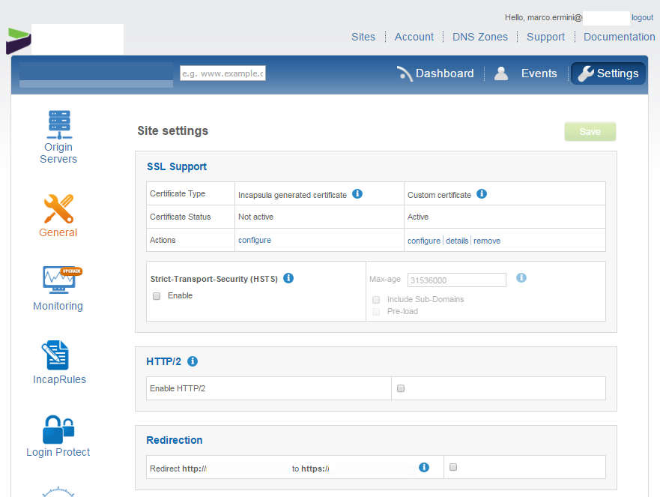
Cloud WAF/CDN

Slide 48
Open Source information gathering
Backup Slides

Slide 49
Open Source Intelligence
Collection of free tools and source of information
They divide into
Tools which can run locally
Search Engine “dorking” (e.g. Google hacking)
Semi-closed sources
Exploitation of sites which have originally other purposes (e.g. social networks, dating sites…)
<number>

Slide 50
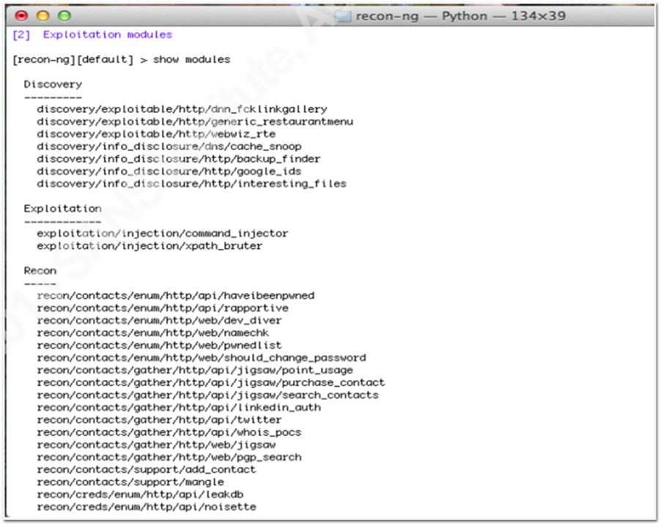
METASPLOIT recon-ng
<number>

Slide 51
FOCA Search
<number>

Slide 52
Job Posting’s Harvesting
<number>

Slide 53
Job Posting’s Harvesting
<number>

Slide 54
Job Interviews’ Harvesting
<number>

Slide 55
robtex.com
<number>

Slide 56
robtex.com
<number>

Slide 57
Harvesting of Corporate Emails
<number>
Notes:
LinkedIn is available if you are determined (need to bypass brute force checks)
<number>
12/06/2017

Slide 58
Gathering of domain names
<number>
Notes:
Enumeration via wordlists
<number>
12/06/2017

Slide 59
Gathering of domain names
<number>
Notes:
Recursive DNS enabled to the world
Private IP addresses revealed
SPF records disclosing the email technologies used
Enumeration of SIP records
<number>
12/06/2017

Slide 60
NMAP
<number>
Notes:
Can combine with shodan.io and other scripts
<number>
12/06/2017

Slide 61
Old (and new) fashion scanning
<number>
Notes:
nmap: scan few hosts for open ports/services
zmap: scan lots of hosts for a single port/service. “On a computer with a gigabit connection, ZMap can scan the entire public IPv4 address space in under 45 minutes. With a 10gigE connection and PF_RING, ZMap can scan the IPv4 address space in 5 minutes.”
<number>
12/06/2017

Slide 62
Maltego
<number>

Slide 63
Maltego
<number>

Slide 64
Maltego
<number>

Slide 65
Maltego
<number>

Slide 66
Maltego
<number>

Slide 67
Maltego
<number>

Slide 68
censys.io (semi-free)
Parsing and collection of various publically-available information
Example: certificates
SSLVPN in France and Munich
Date Center presence in Munich, San Diego, Sydney
Demo-site of Hybrid (e-commerce technology)
Using Akamai services in Sydney
<number>

Slide 69
censys.io - Geolocation
<number>

Slide 70
shodan.io
<number>

Slide 71
VIPs “Dorking”
<number>

Slide 72
VIPs “Dorking”
<number>

Slide 73
VIPs “Dorking”
<number>

Slide 74
VIPs “Dorking”
<number>

Slide 75
Cyber Security Ratings Firms
<number>

Slide 76
CyberSecurity Ratings Firms
<number>

Slide 77
CyberSecurity Ratings Firms
<number>

Slide 78
CyberSecurity Ratings Firms
<number>

Slide 79
CyberSecurity Ratings Firms
<number>

Slide 80
Data Breaches
<number>

Slide 81
CyberSecurity Ratings Firms
<number>

Slide 82
CyberSecurity Ratings Firms
<number>

Slide 83
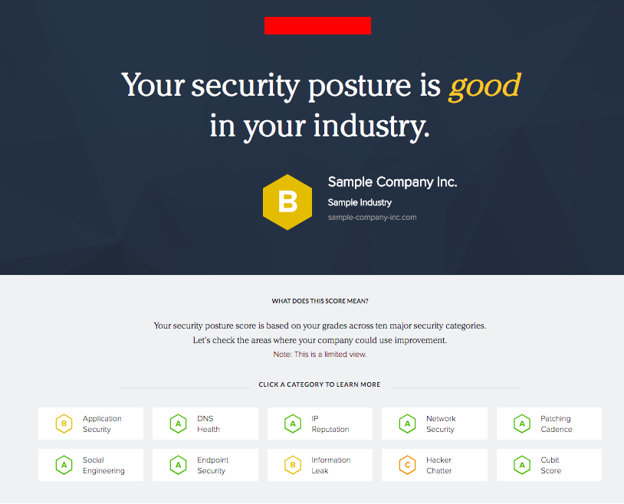
CyberSecurity Ratings Firms
<number>

Slide 84
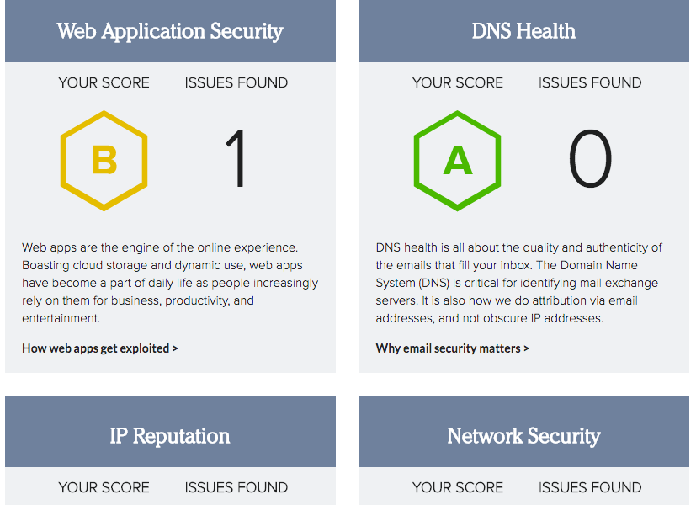
CyberSecurity Ratings Firms
<number>

Slide 85
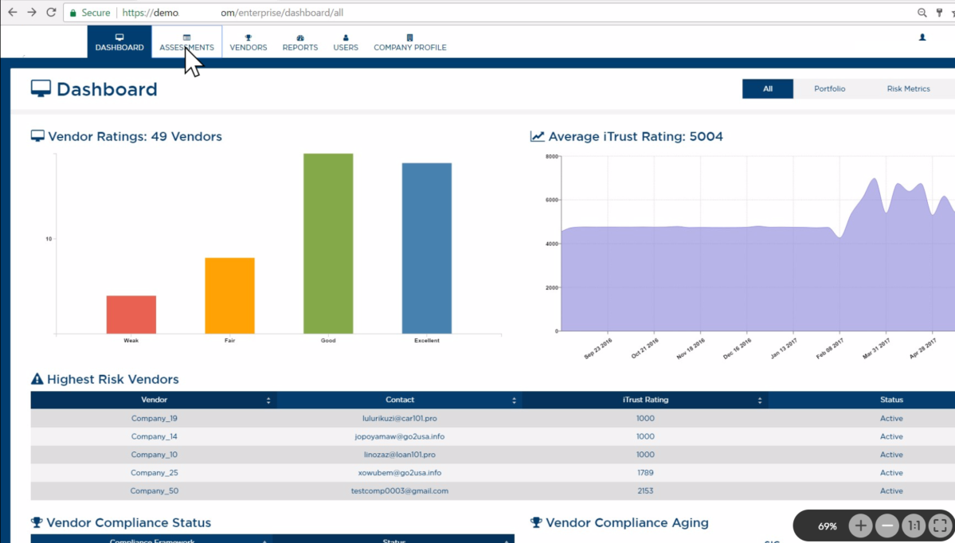
CyberSecurity Ratings Firms
<number>

Slide 86
Bibliography
“Mergers and Acquisitions Security – Corporate Restructuring and Security Management” (E.P. Halibozek, Dr. G.L. Kovacich), Elsevier, 2005
“Information Security in Mergers & Acquisitions” (C. Conacher), Black Hat 2004
“Handling mergers and acquisitions: Career success tips for infosec pros”, searchsecurity.techtarget.com
“Using Open Source Reconnaissance Tools for Business Partner Vulnerability Assessment” (SANS Institute InfoSec Reading Room), 2014
“Why people integration continues to dominate M&A challenges”, PWC, 2012
“Plan and Execute an Active Directory Merger”, windowsitpro.com, 2009
“The Three Steps to Consolidate the Active Directory Environments of Merging Organizations”, binarytree.com, 2015
“Collaborations, mergers, acquisitions, and security policy conflict analysis” (V. Subramanian, R. Seker, J. Bian, N. Kanaskar, acm.org, 2011
“Alignment of the IS Organization: the Special Case of Corporate Acquisitions” (C.V. Brown, J.S. Renwick), 1996
“M&A loves the cloud”, “M&A Trends”, Deloitte, 2016
“Driving growth and competitiveness: Can the power of cloud lift M&A value into the stratosphere?”, Accenture, 2016
“Lifecycle of a Technology Company – Step-by-step legal background and practical guide from start-up to sale”, E.L. Miller Jr., John Wiley & Sons, 2008
“Mergers and Acquisitions from A to Z” 3rd ed., A.J. Sherman, AMACOM, 2011
“Digging for Disclosure – Tactics for Protecting Your Firm’s Assets from Swindlers, Scammers, and Imposters”, K.S. Springer and J. Scott, Pearson Education, 2011
“Mergers & Acquisitions For Dummies Cheat Sheet” – dummies.com
“The Complete Guide to Mergers & Acquisitions: Process Tools to Support M & A Integration at Every Level, Third Edition”, T.J. Galpin, Wiley, 2014
<number>

Slide 87
THANK YOU!
Marco Ermini
2018

